Slide 1

VIDEO GAMES SALES
BY SHIVANSH KASHYAP

Slide 2

THE PROBLEM
Nearly 10000 video games are made every year. These games range from being AAA to simple indie games.
Understanding the relationship between different platforms, genres, scaling of the project can help us understand the current consumer market for this industry.

Slide 3
IS IT INTERESTING
In 2023, the Video Games market is projected to reach a revenue of US$249.60bn. It is expected to grow at an annual rate of 9.83% between 2023 and 2027, resulting in a projected market volume of US$363.20bn by 2027. Compared to the gaming industry in the entertainment category, the Film Industry is less valued at $42.5 billion to $145.7 billion. The domestic box office generated a revenue of $5.99 billion as of 2022.
So an approach that helps us understand the statistics behind this industry would be helpful to know what factors are the most common behind a successful videogame.

Slide 4
APPROACH TO THE PROBLEM
The first step would be to process the data and visualize it into different categories like most sales, popularity by genre, sales by continent.
The next step would be find the most common denominator among the successful games over different platforms, genres and regions.

Slide 5
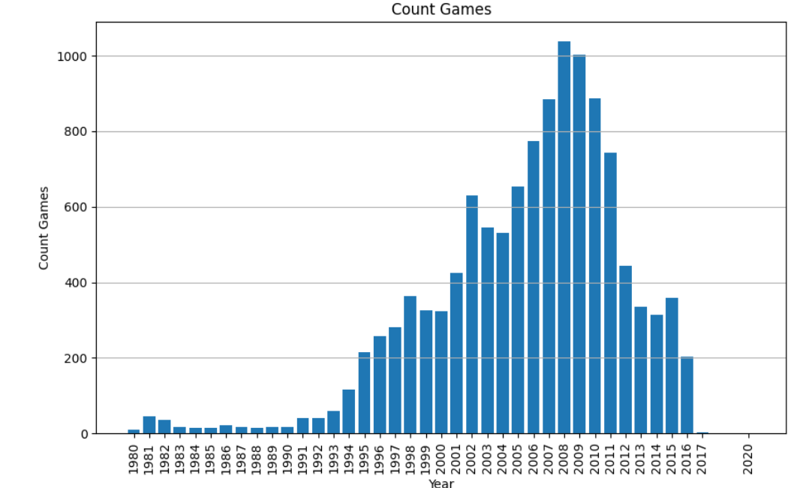
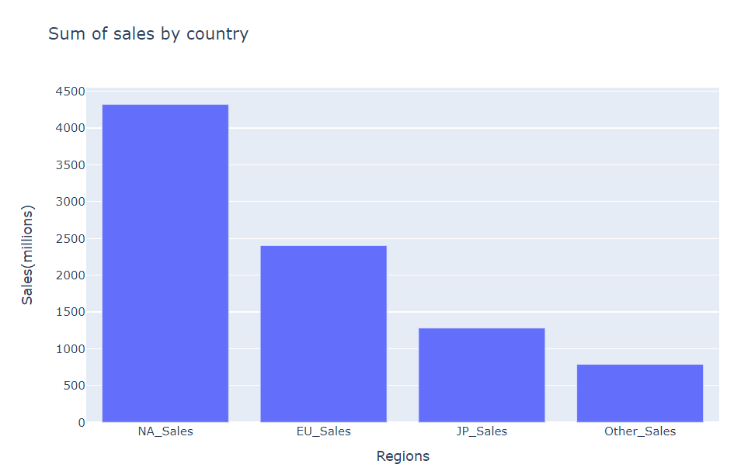
DATA VISUALIZATION

Slide 6
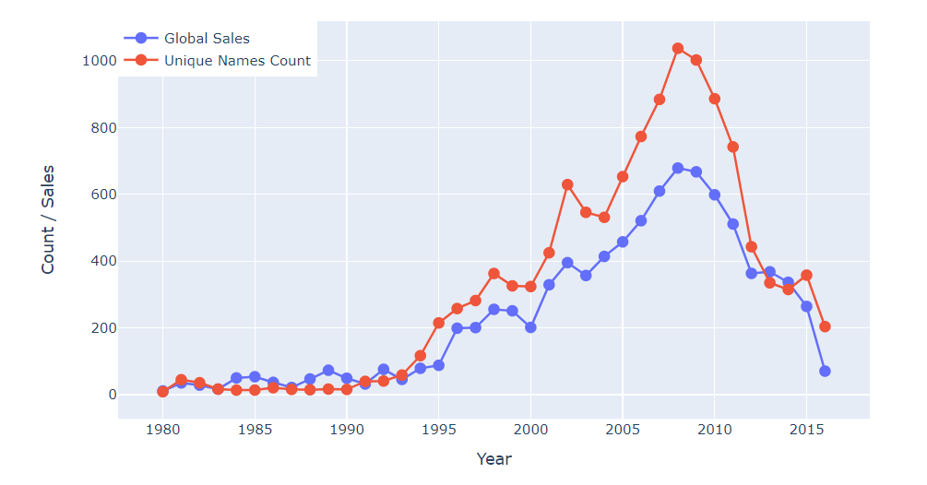
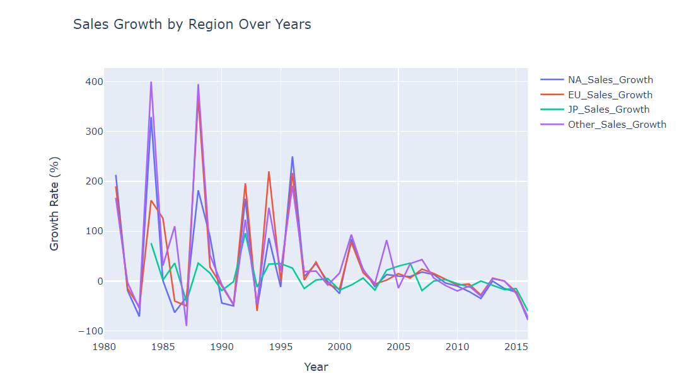
DATA VISUALIZATION

Slide 7
THANK YOU

